Slide 1
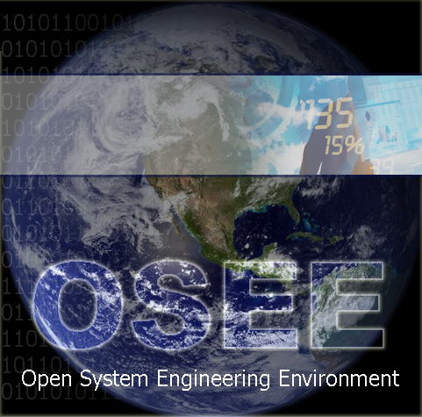
Open System Engineering Environment – An Integrated Solution
http://www.eclipse.org/osee/
EclipseCon 2008
2008-03-20 3:00 - Room 203/204
Ryan Brooks, Don Dunne
Copyright © 2008 Boeing. Made available under the Eclipse Public License.

Slide 2
Deep Collaboration
“The historical way of developing products just doesn't work when you're as ambitious as we are. When the challenges are that complex, you have to develop a product in a more collaborative, integrated way.¹”
Jonathan Ive, head of design – Apple
Engineering a product in a more collaborative, integrated way requires an environment that is itself tightly integrated.
¹ Grossman, Lev. "How Apple Does It" Time 24 Oct 2005. <http://www.time.com/time/archive/preview/0,10987,1118384,00.html>.
Notes:
Enable automated, concurrent flow of information
Lean because you can Embrace Change
Minimize knowledge loss

Slide 3
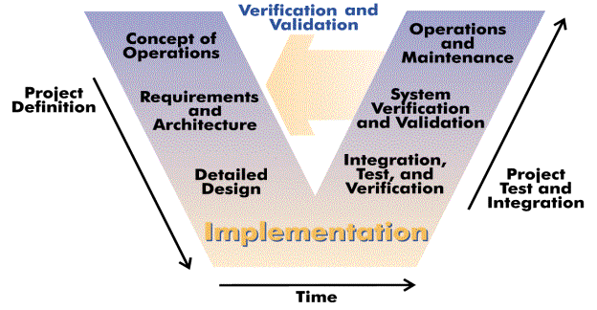
V-Model / Systems Engineering
OSEE provides a tightly integrated environment that supports lean engineering. It is integrated around a simple, user-definable data model to eloquently provide bidirectional traceability across the full product life-cycle including: architecture and design, requirements management, implementation, verification, and validation.
Image Source: http://en.wikipedia.org/wiki/V_model
Notes:
Systems engineering is defined as "a branch of engineering whose responsibility is creating and executing an interdisciplinary process to ensure that customer and stakeholder's needs are satisfied in a high quality, trustworthy, cost efficient and schedule compliant manner throughout a system's entire life cycle, from development to operation to disposal.” INCOSE
Although OSEE was born out of Engineering Flight Software for Boeing Apache Attack Helicopter, it can be applied to all systems engineering from smallest 1-2 person project to large 1000 person DoD program. == Not just an Avionics Platform
No matter the size, it’s imperative to ensure that customer requirements are being met. For many projects, this is an after-thought or something to verify at delivery. This is due to complexity of tracking requirements all the way down to application code and unit tests.
With the ability to store and relate all the data at time of creation, it is possible to maintain and ensure that requirements are being decomposed and met and see live metrics throughout the project.
Open Source Extensible Platform
Open Eclipse Project w/ Collaboration
Tight Integration Around A Common Data Model
Full Lifecycle Engineering Environment

Slide 4
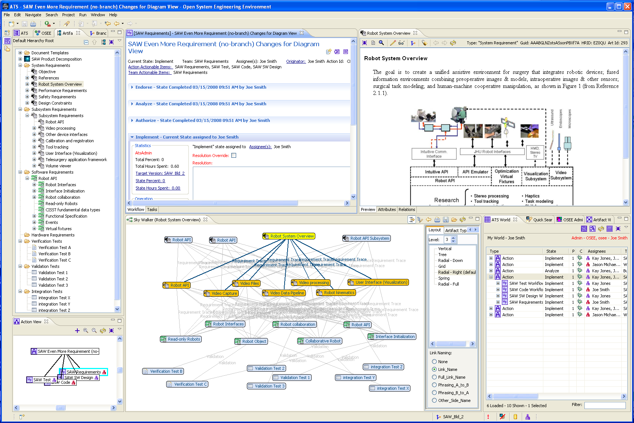
Notes:
The view providing data visualization that shows the traceability between artifacts utilizes the Zest Viewer. We learned about he Zest Viewer at EclipseCon last year and integrated it before we left from EclipseCon.

Slide 5
Key Project Activities and Timeline
Nov 2004 – Test Environment first used for requirements verification in simulated environment
EclipseCon 2007 – Explored idea for Eclipse project
July 10, 2007 – Project proposal approved
Aug 10, 2007 – Incubation Phase (conforming)
Nov 8, 2007 – Delivered OSEE w/database to US Army
Dec 8, 2007 – Initial source commit (140K LOC)
Summer 2008 – Next major source commit: Test Environment for embedded software (45K LOC)
Summer 2008 – Upcoming first flight of next generation Apache Helicopter represents major maturity milestone for OSEE
Notes:
Eclipse and Industry Verticals: The healthcare experience by Grahame Grieve
Test Environment for Simulated and Real-time embedded testing

Slide 6
OSEE Collaboration
7 talented committers
4 contributors
Recruit and mentor new contributors and committers
Work with interested parties including:
Integration with other Eclipse Projects
Arizona State University | Auburn University
Bosch | EADS
Lockheed Martin, Advanced Technology Laboratories | Rockwell Collins
General Motors | United States Army
Notes:
Eclipse and Industry Verticals: The healthcare experience by Grahame Grieve

